Slide 1
The Different Ways to Use Screencastify
By Brooke and Karter

Slide 2
How to Download Screen Capture
Get on your google chrome and sign in to your account. Next go to the chrome web store and search Screencastify. Press add to chrome and it will immediately be attached to your chrome and you can access it by the orange arrow in the top right of your screen.

Slide 3
How to use Screencatify
Once Screencatify is downloaded you can press the orange arrow in the top right of your screen. Once pressed you will see Browser Tab, Desktop, and Webcam Only. Once you decide what you want to record choose out of the three. Make sure your microphone is enabled if you want people to hear you from your video. Also if you select Browser Tab or Desktop you have the option to enable webcam at the dame time.

Slide 4

Browser Tab
The browser tab is used when you would like the students hear you, and see your screen. Also when you press to enable browser tab you have the option to enable your webcam as well so that people can see you while you show your browser tab.

Slide 5
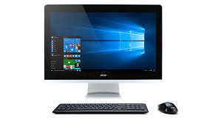
Desktop
Desktop is best used when you would just like the students to see your screen and hear your voice. You can also enable webcam so students can see your face as well.

Slide 6
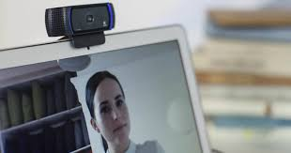
Webcam Only
Webcam only is when you would just like the students to see and hear you.

